Slide 1

Weekly report
Real Estate
- Group member:
Dương Hoàng Linh
Nguyễn Minh Tâm
Nguyễn Phi Hùng

Slide 2
1. Introduction
  Target
Build a real estate platform for Smart City, which allows:
Real estate owners:
+ Log in as a lessor (homeowner)
+ Initialize / edit / delete rental property information
+ Verify the owner of that property
+ Negotiate terms with tenants
+ Review rental history
+ Revenue and Cost Management
Real estate tenant:
+ Log in as a tenant
+ Search by location / price / nature of properties
+ Re-negotiate terms with the owner
+ Real estate rental

Slide 3
1. Introduction
  Target
This platform provides payment systems such as electronic money (ETH / BTC / ...), real money (ATM / VISA / ...).
Each property will have a limit list of owners (verified by ID). When the tenant agrees to rent, his or her ID will be added to the tenant's limited list for the negotiated lease period.
This platform reduces commissions for both owners and tenants, and transactions more quickly.

Slide 4
1. Introduction
  Importance
This platform creates a transaction environment with low commission costs, faster transactions. Reduce the spurious cases in real estate. Maintain transparency through smart contract.

Slide 5
2. Related Works
Customers in Hawaii have about 50 real estate, half for local residents and the rest for tenants during vacation.
For vacationers, customers use the AirBnB service, but the commission costs for AirBnB are very high and transactions are slow.
Airbnb (AirBed and Breakfast),a startup that connects people with rental needs around the world through a mobile application similar to the Uber car sharing application. All payments will be made through Airbnb, using a credit card and the mediator will charge a fee to both the reservation and the host.

Slide 6
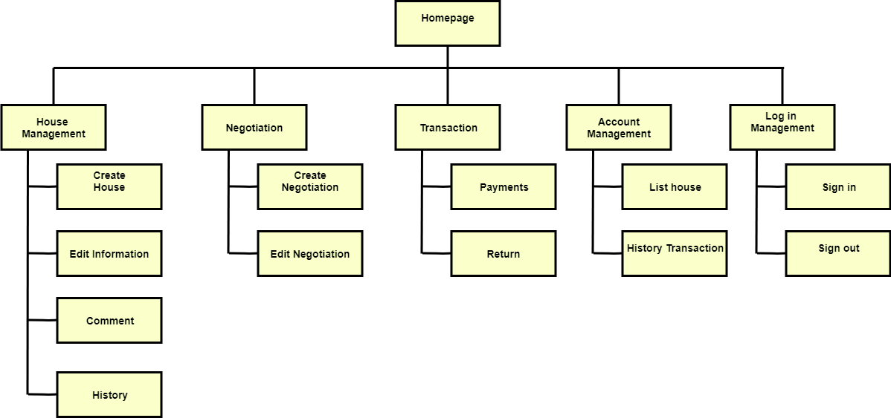
3. Diagram
  Business Functional Diagram
Notes:
According to Airbnb website and some related examples, we have drawn some diagrams to illustrate main features for our project included existing ones and some additional features which are created from us.

Slide 7
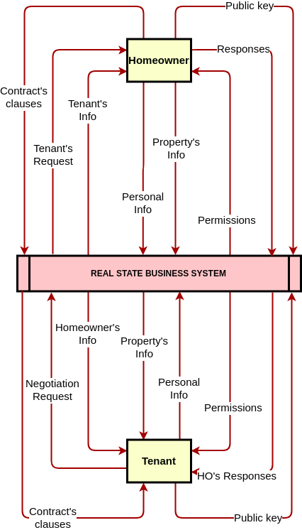
3. Diagram
  Data Flows Diagrams (3 levels)
  Level 0:
Notes:
There are two main factors/instances in our project, we call them Homeowner and Tenant. Both sides have to provide their identify key for verifying their own identity. We also need those keys for getting user’s information.
Each role have its own permission to use the web app.

Slide 8
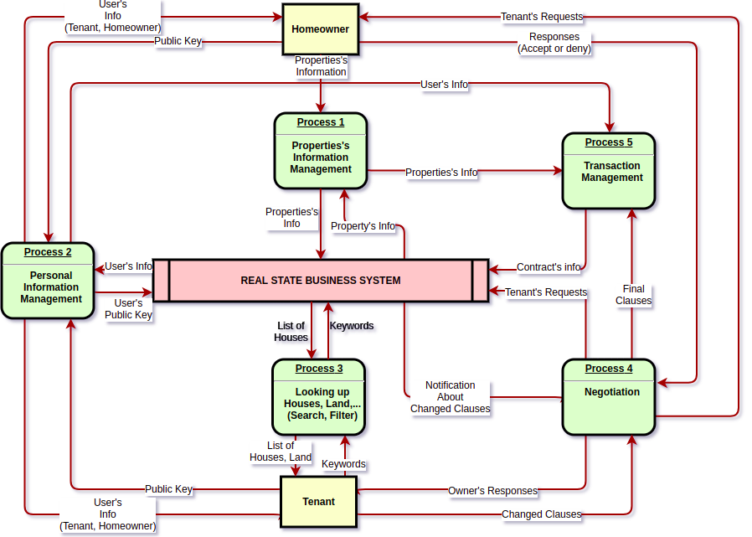
3. Diagram
  Data Flows Diagrams (3 levels)
  Level 1:

Slide 9
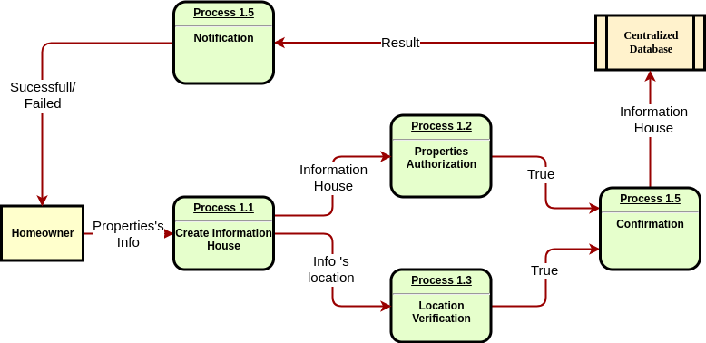
3. Diagram
  Data Flows Diagrams (3 levels)
  Level 2: Process 1: Property management

Slide 10
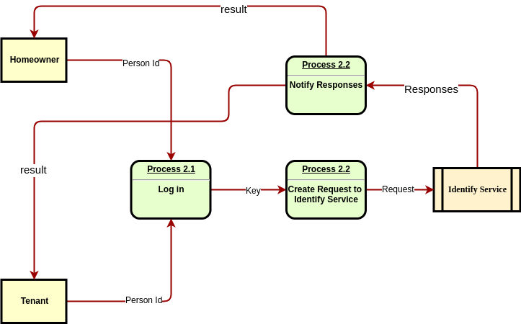
3. Diagram
  Data Flows Diagrams (3 levels)
Level 2: Process 2: Personal Info Management

Slide 11
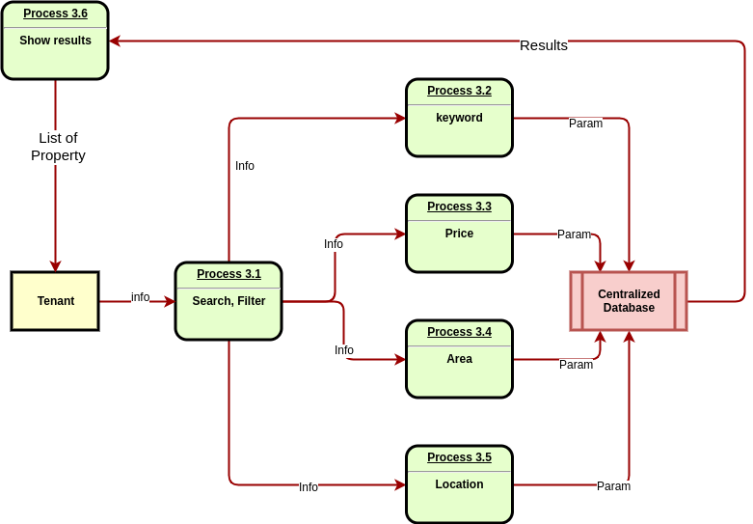
3. Diagram
  Data Flows Diagrams (3 levels)
Level 2: Process 3: Looking up property

Slide 12
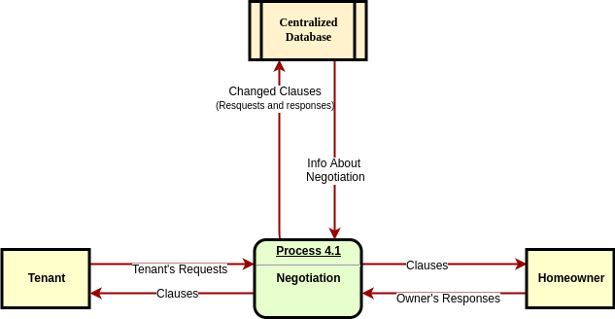
3. Diagram
  Data Flows Diagrams (3 levels)
Level 2: Process 4: Negotiation

Slide 13
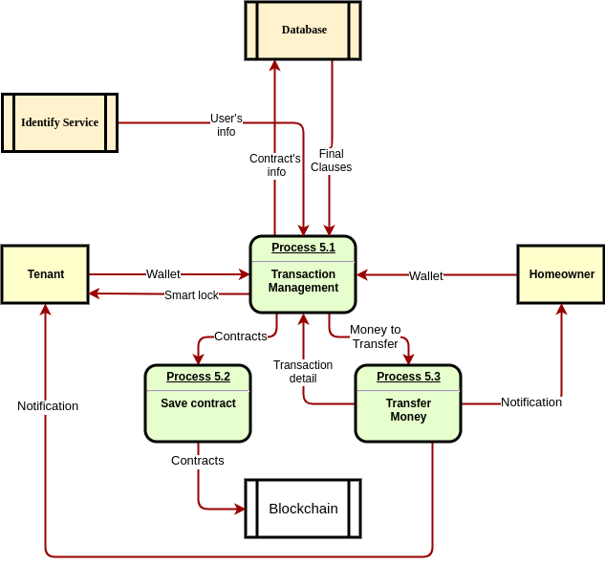
3. Diagram
  Data Flows Diagrams (3 levels)
Level 2: Process 5: Transaction management

Slide 14
4. Blockchain
Technology for web app
We decided to use client-server architecture for this project. We will build separately an API as a back-end service with a front-end (written in HTML/CSS/JS).
Blockchain is responsible for storing immutable data, such as contract details and historical user transactions.
An API will be written in NodeJS using MVC architecture and interact with Smart Contracts through Web3.js library.

Slide 15
4. Blockchain
Technology for decentralized storage (IPFS)
IPFS is a protocol that allows users to share peer-to-peer files without a server.
Content uploaded by the user will be hashed and generated a code. Content shared by a node is split into fragments, then they will be taken to the nodes near it in the network.
When you want to download a file, a node will ask the server to look in a scattered hash table that contains information for all the nodes in the network to find out the nodes that store the pieces of the content.

Slide 16
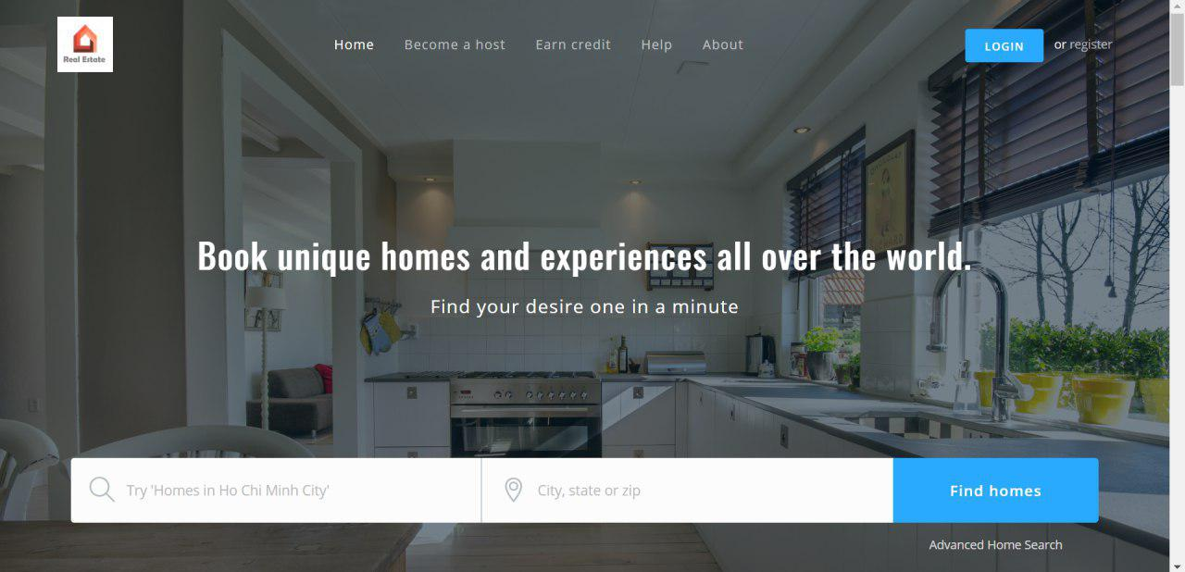
5. Frontend
Online link: https://real-estate-uit.herokuapp.com/
Homepage

Slide 17
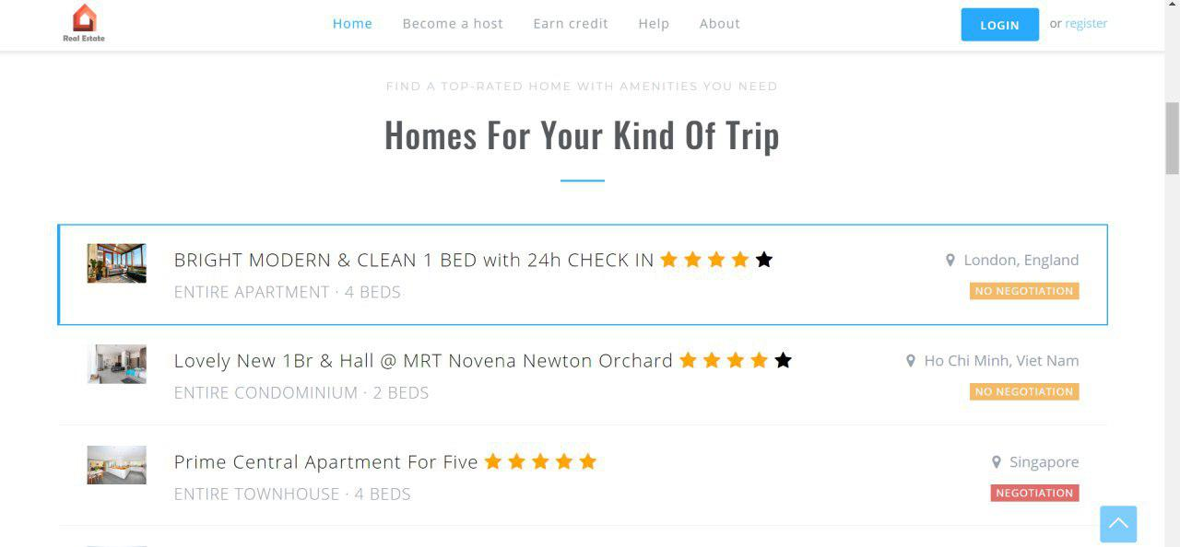
5. Frontend
Online link: https://real-estate-uit.herokuapp.com/
Homepage

Slide 18
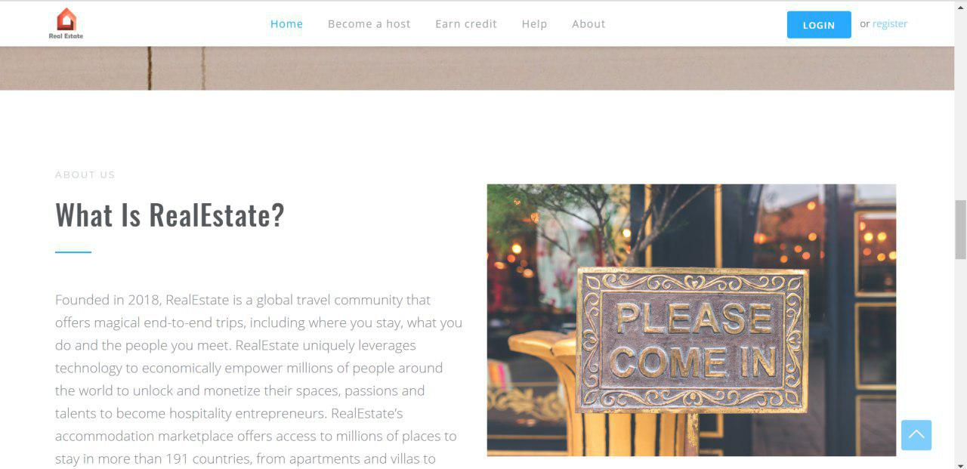
5. Frontend
Online link: https://real-estate-uit.herokuapp.com/
Homepage

Slide 19
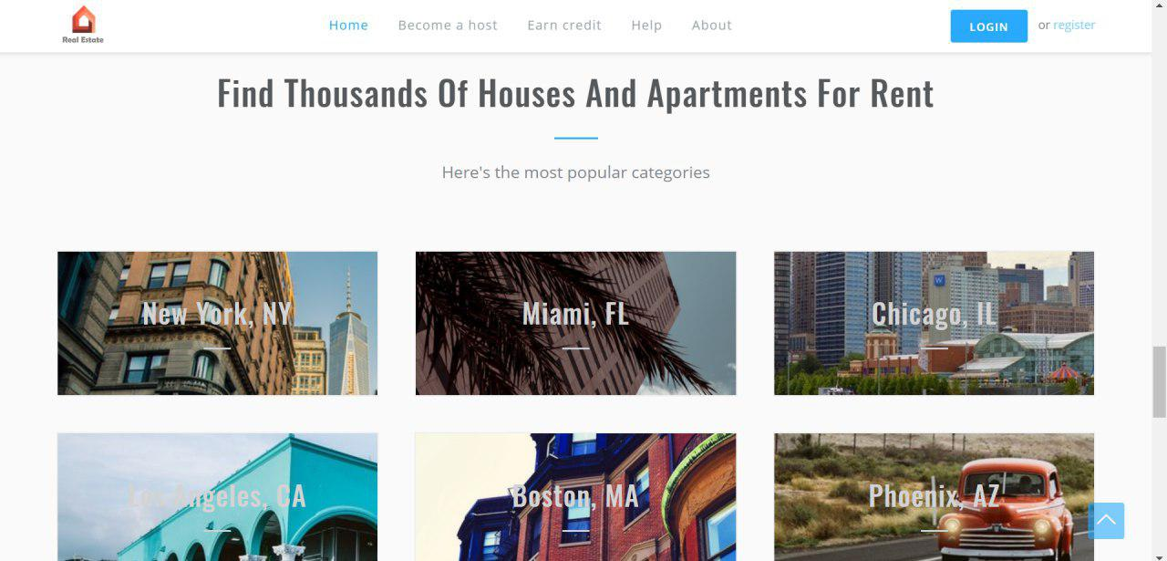
5. Frontend
Online link: https://real-estate-uit.herokuapp.com/
Homepage

Slide 20
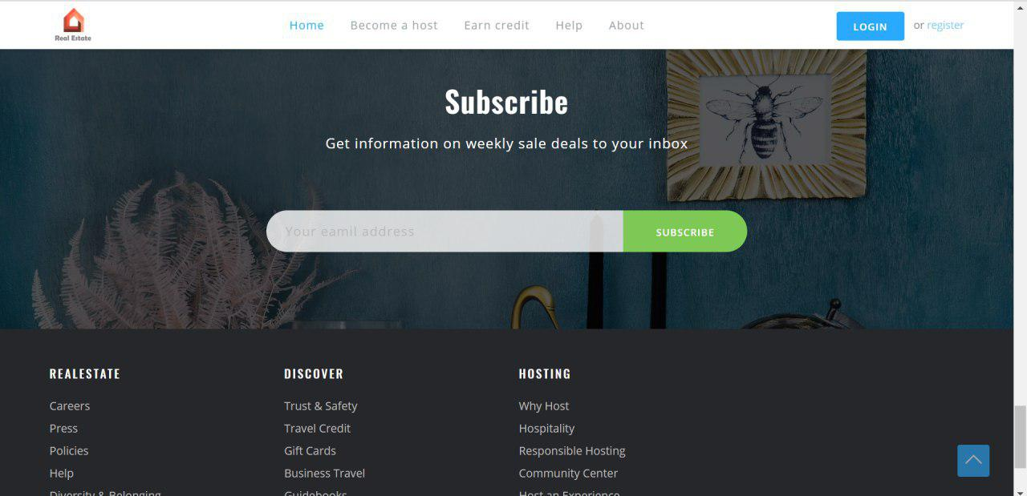
5. Frontend
Online link: https://real-estate-uit.herokuapp.com/
Homepage

Slide 21
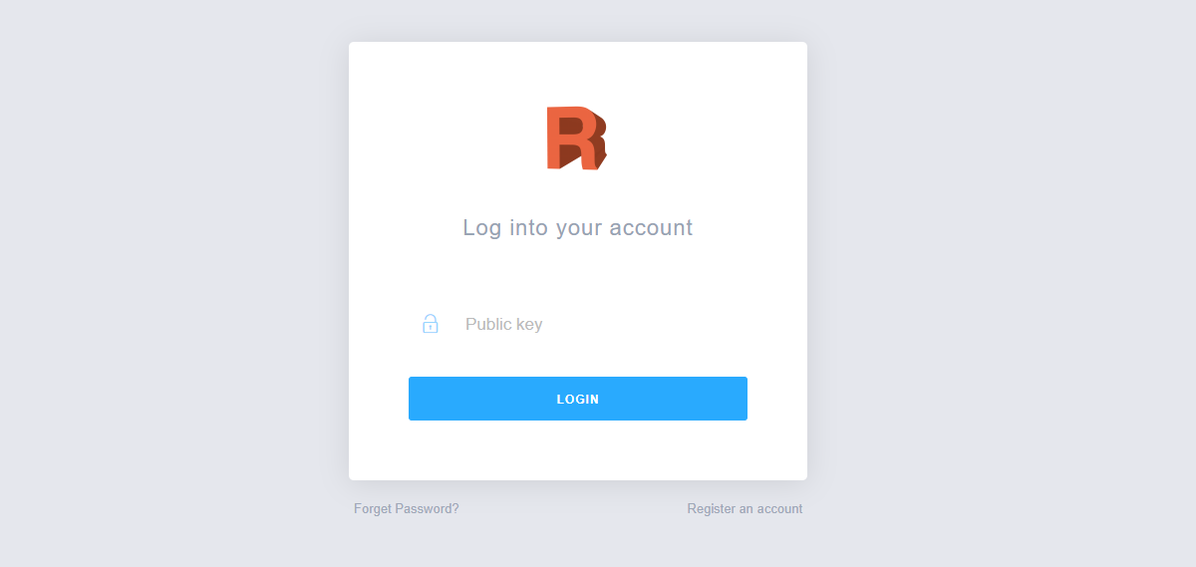
5. Frontend
Online link: https://real-estate-uit.herokuapp.com/
Login page

Slide 22
Thanks for your listening!!!

